Slide 1
Predicting Delivery Delays in E-Commerce Supply Chains
DATA 606 Capstone in Data Science
Advisor: Dr. Chaojie Wang
Sree Charan Reddy Kailasam
NJ36656

Slide 2
Problem Statement
E-commerce struggles with on-time delivery.
Late deliveries affect:
Customer satisfaction
Seller ratings
Logistics cost

Slide 3
Objectives
1. Predict Late vs On-Time Deliveries
2. Estimate Expected Delay in Days
3. Identify the Strongest Drivers of Delays
4. Understand Seasonal & Regional Delay Patterns

Slide 4
Dataset Overview
Final Combined Dataset
~100,000 complete orders (after cleaning)
Time period: 2016–2018
Unit of analysis: 1 row = 1 order with full details
Merged 8 Olist datasets into one unified modeling dataset.

Slide 5
Data Cleaning
Performed:
Dropped duplicates
Removed missing target values
Converted all timestamps
Created delay labels
Merged geolocation
Engineered distance feature

Slide 6
Target Variable
Late Delivery = delivered date > estimated date
On-time ~90%
Delayed ~10%
Strong class imbalance
Strong class imbalance → needed SMOTE to help the model learn delayed cases.

Slide 7
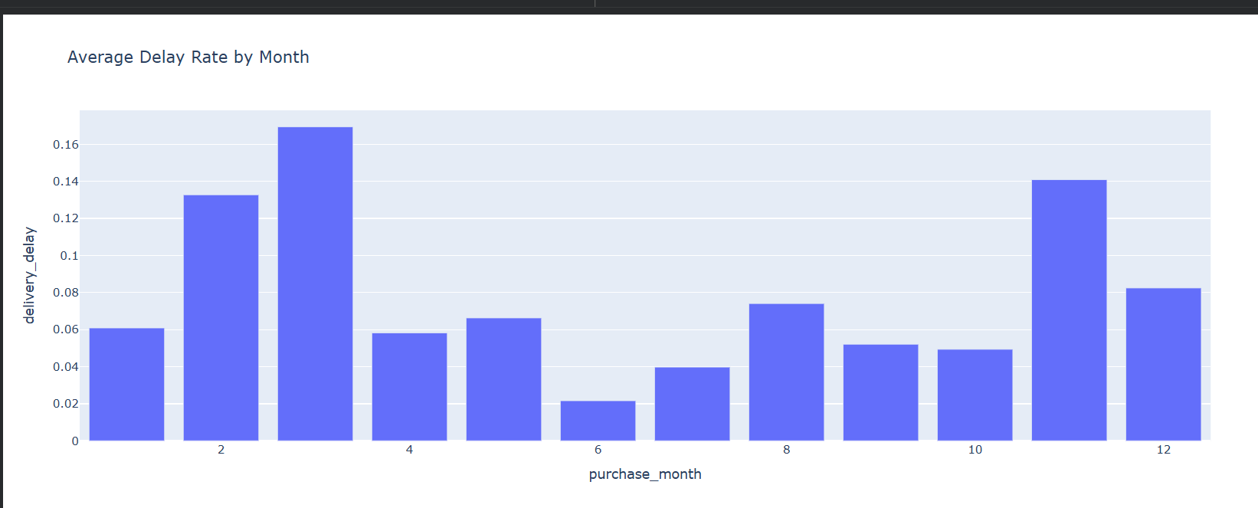
Delay by Month

Slide 8
Key Model Features
Top predictors influencing delays:
Distance (customer → seller)
Product weight & volume
Purchase month & weekday
State-to-state route
Delivery gap (ETA days)

Slide 9
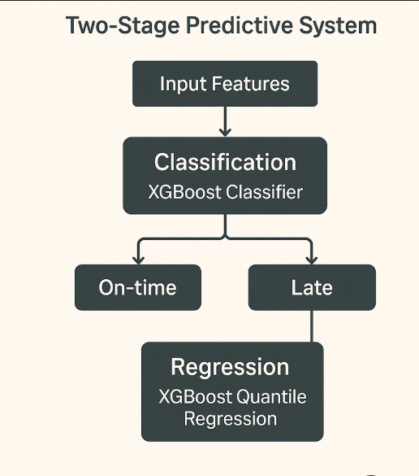
Model Design
Two-Stage Predictive System
1. Classification Model — XGBoost Classifier
Predicts whether an order will be Late vs On-time
2. Regression Model — XGBoost Quantile Regression
Predicts Days Late for orders classified as delayed
Median quantile model (0.5 alpha)

Slide 10
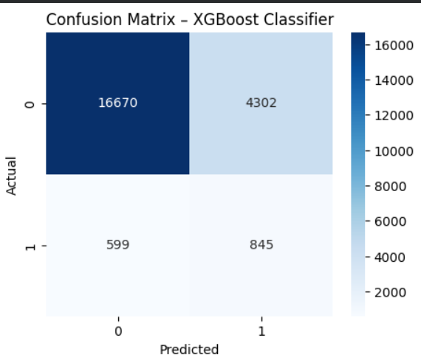
Results
Classification Model
Accuracy: 0.78
ROC-AUC: 0.76
Recall for delayed class: 0.59
Regression Model
highly skewed
predicting the median gave more stable, realistic delay estimates.
MAE ≈ 5.1 days

Slide 11
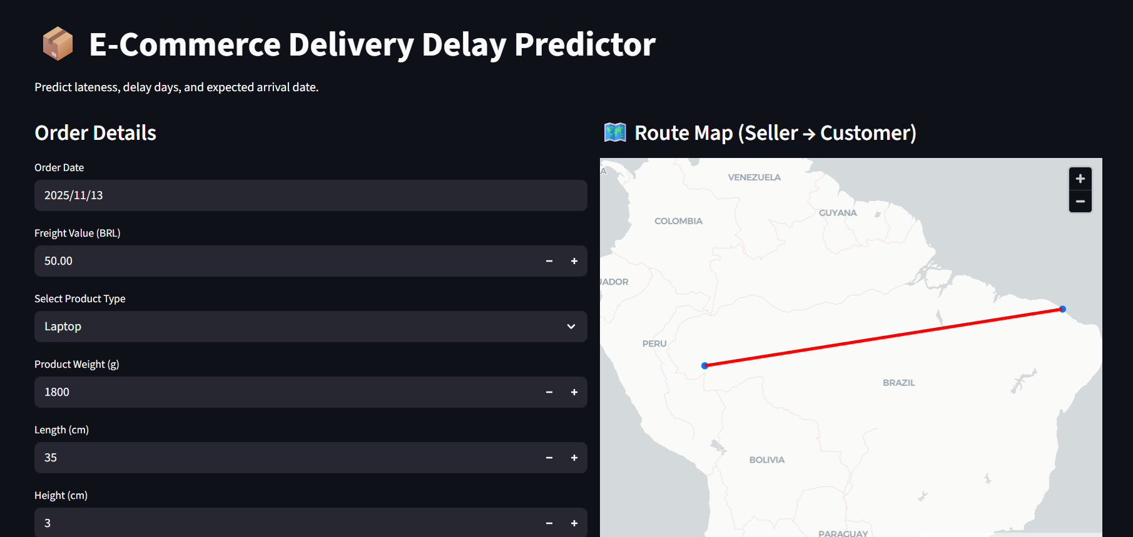
Streamlit App Overview
Streamlit app does:
Predict late/on-time
Predict delay days
Show route map
Provide expected arrival date

Slide 12
Business Insights
Distance is the biggest driver
March & December need capacity planning
Heavy & bulky items are more delay-prone
Some states consistently underperform
Estimated delivery dates can be improved

Slide 13
Future Work
Add weather and traffic data
Retrain on post-pandemic data
Deep learning for route clustering
Real-time prediction for live orders

Slide 14
Conclusion
Built a complete ML pipeline
Achieved strong classification performance
Regression model gives practical delay estimates
Streamlit tool demonstrates real-world applicability

Slide 15
Thank You
Questions?

